Slide 1

McDonald's Financial Health Overview
This Power BI dashboard showcases McDonald's financial performance through unique KPIs and trend visuals. It highlights insights like Cash to Debt Coverage and Revenue per Share, offering a smart overview of financial stability and growth over time.
Joshwa Rajkumar
A Power BI Dashboard Analysis
25 – April – 2025

Slide 2

💰 Cash to Debt Coverage Ratio
This KPI visual highlights how well McDonald’s is managing its financial obligations by comparing cash reserves against total debt. A healthy ratio indicates the company’s strong liquidity position and ability to handle debt repayment smoothly.

Slide 3
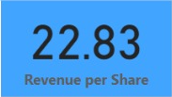
📈 Revenue Per Share
This metric breaks down the total revenue generated per outstanding share. It offers a clear picture of how effectively the company converts its income into shareholder value, providing insights into profitability on a per-share basis.

Slide 4
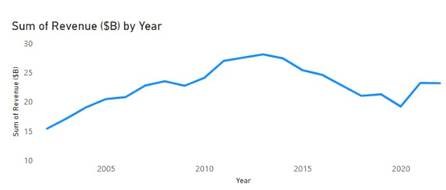
📊 Yearly Revenue Trend
This line chart visualizes revenue changes across years. It helps stakeholders quickly identify growth patterns or declines, making it easier to assess long-term performance and strategic decisions over time.

Slide 5
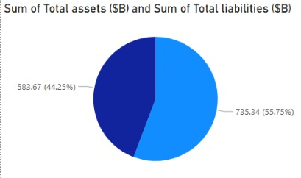
Total Assets vs Total Liabilities
McDonald's total assets account for 55.75% compared to 44.25% liabilities, indicating a healthy asset base relative to its obligations.

Slide 6
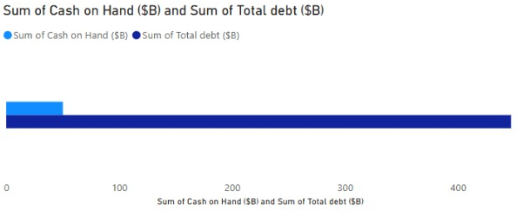
Cash on Hand vs Total Debt
McDonald’s total debt is significantly higher than the cash on hand, suggesting a need for efficient cash flow management.

Slide 7

Revenue Trend Over Years
Revenue has shown consistent growth with a slight dip around 2020, likely due to the pandemic, and recovery afterward.

Slide 8
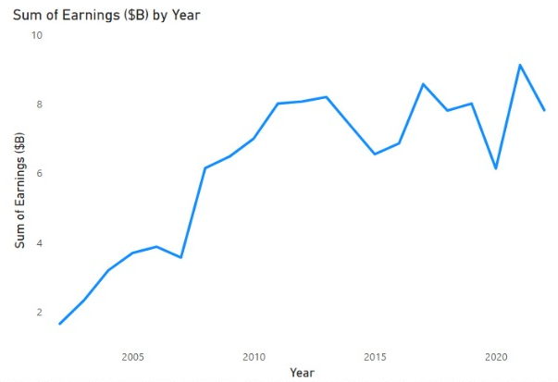
Earnings Trend Over Years
Earnings have fluctuated but have maintained an overall upward trend, reflecting business resilience and profitability over the years.

Slide 9
Conclusion
McDonald’s financial health is strong in terms of asset holding.
Revenue and earnings trends show growth despite external challenges.
Monitoring debt levels and cash reserves remains critical.
Thank You!

